Slide 1
Collaborative University Android App
Adeel Asghar
Hala Ali
Palak Patel
Tyler Gross
Notes:
Presenter - Adeel

Slide 2
Feature Implementations
CI/CD Jenkins server
MVVM Architecture
MAIN FORUM
LOGIN/REGISTER activities
Dependency Injection and Dagger
Firebase Realtime Database
NoSQL Database Schema
Notes:
Presenter - Adeel

Slide 3
MVVM Architecture
Activity/Fragment – UI triggered events are implemented with shallow logic
ViewModel – Business Logic is implemented that connects to repository
Repository – Database and Network Calls are implemented
Firebase Realtime Database – User account data and user posts are stored
Notes:
Presenter - Adeel

Slide 4
Dependency Injection and Dagger
Loosely-coupled, easy to maintain code
Prevents dependency loops
Database injected into repository
Repository injected into view model

Slide 5
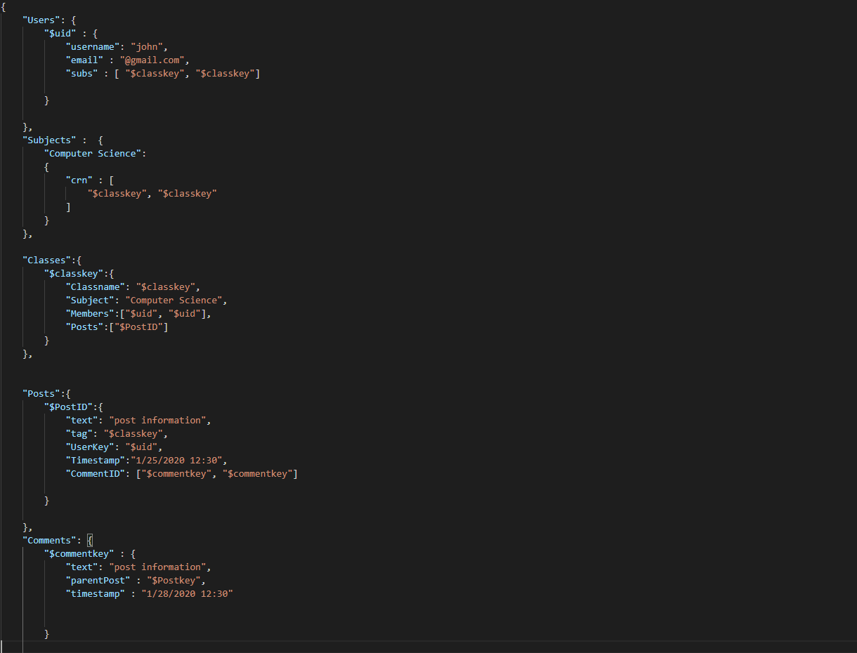
NoSQL Database Schema

Slide 6
Next Steps
Create comments to a post
Search for communities by subject and class title
Create reset password functionality with Firebase functions
Enhance user experience design

Slide 7
Questions
Notes:
Presenter - Tyler

